Slide 1

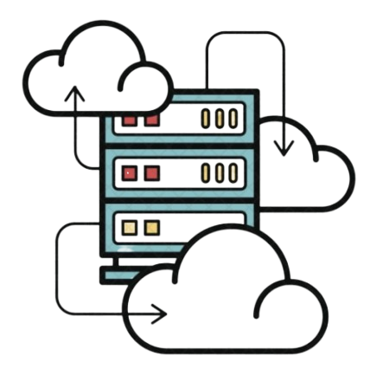
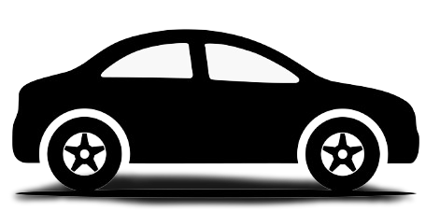



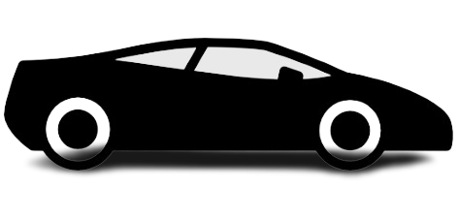
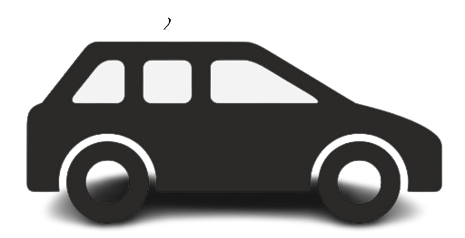
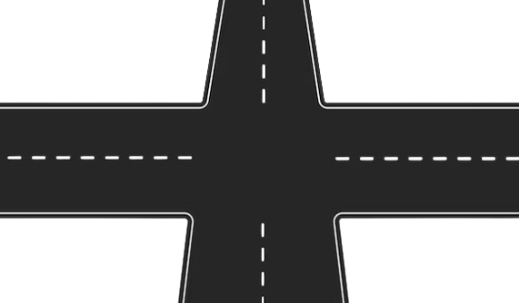
Incoming car registration
3
1
Out going car deregistration
4
2
4
2
3
1
Out going car sensor
Sent the finished data
Server receive the data
Send signal to queue
Incoming car sensor
Sent the direction data to go
Server receive the data
Send signal to queue
Queuing of the cars
Generate.car_id
Push.local_queue
Push.intersection_queue
Give permission to exit
Incoming car registration
After Server received the data
Safe and secure journey
Out going car deregistration
Receive the finish data
Pop.local_queue
Pop.intersection_queue
Delete the car id from server
Activity diagram to queue cars

Slide 2
Incoming car registration
3
1
4
2
Incoming car sensor
Sent the direction data to go
Server receive the data
Send signal to queue
Out going car deregistration
4
2
3
1
Out going car sensor
Sent the finished data
Server receive the data
Send signal to queue

